Slide 1
Traffic Sign Recognition
Anshul Bhardwaj

Slide 2
Problem Statement
Automated Traffic Sign recognition is an important part of self-driving vehicles.
Traffic Signs can provide range of variations between classes in terms of colors and shape.
In this project, I develop Deep Learning algorithms that will train on German Traffic Signs image dataset and them use these algorithms to classify unlabeled Traffic Signs images. The deep learning models will be built using Convolutional Neural Network and Transfer Learning.

Slide 3
Clients / Intended Audience
This model can be used by anyone who wants to what makes an automated self driving system.

Slide 4
Dataset
The dataset used for this project is taken from Kaggle
https://www.kaggle.com/meowmeowmeowmeowmeow/gtsrb-german-traffic-sign
The dataset contains around 4oooo train images and 12000 test images. Metadata is also provided.

Slide 5
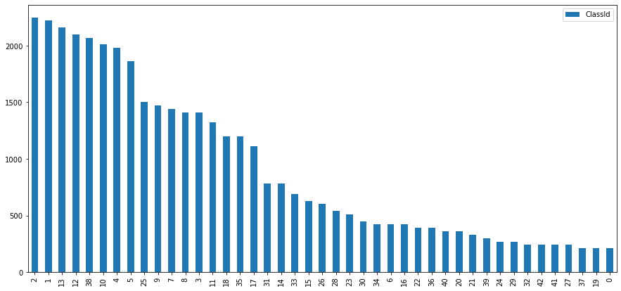
Exploratory Data Analysis
Distribution of Classes

Slide 6
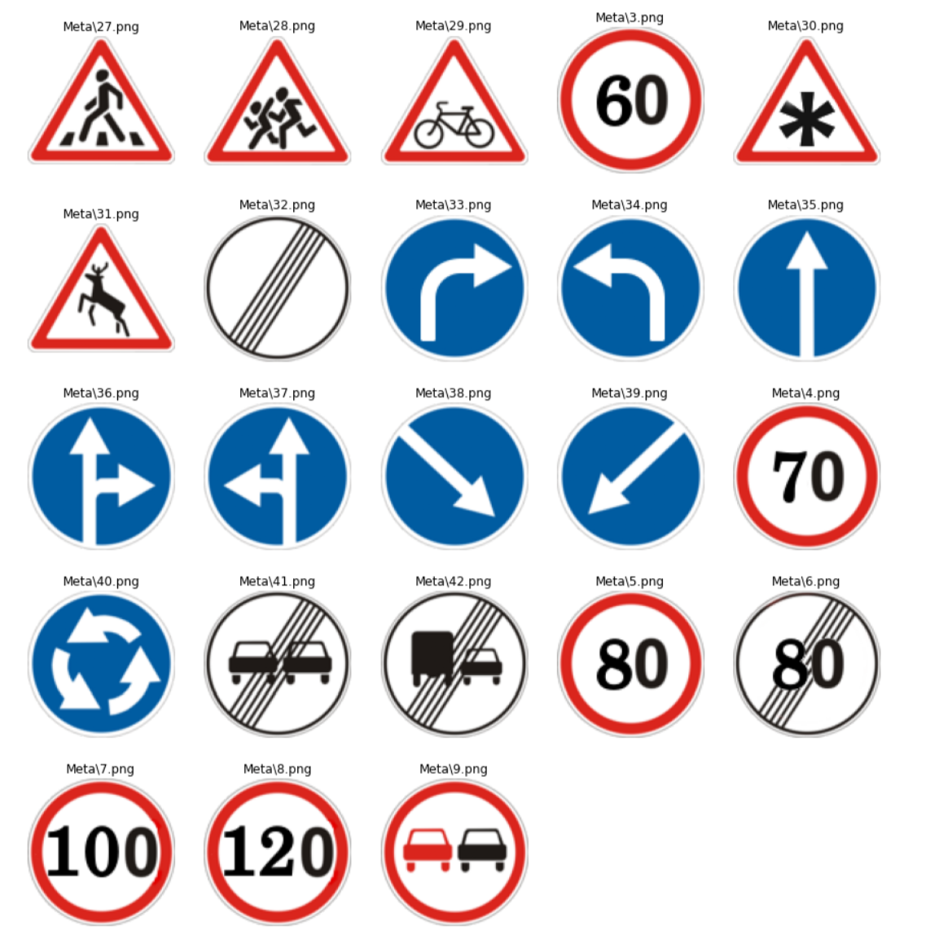
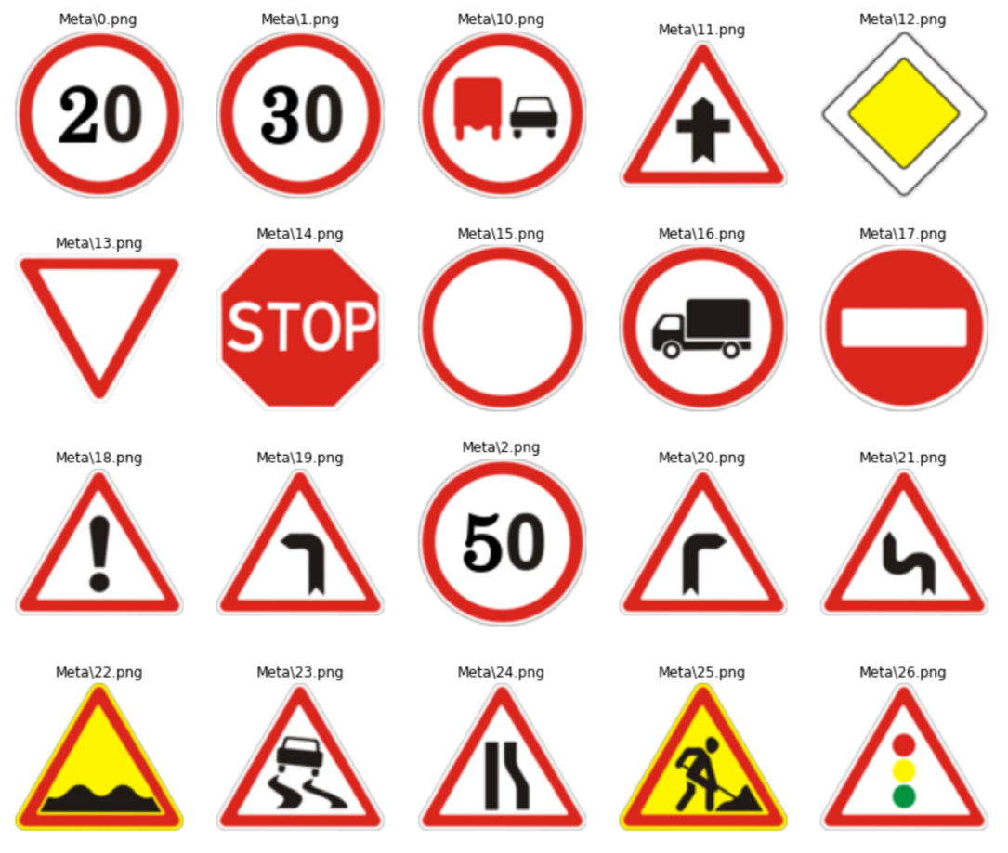
Meta Images

Slide 7
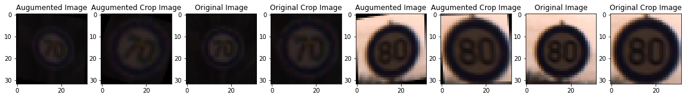
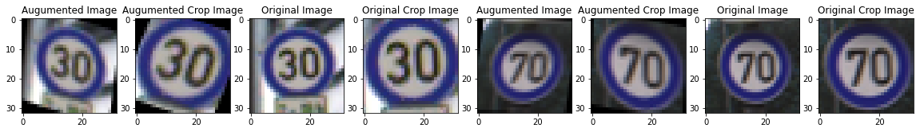
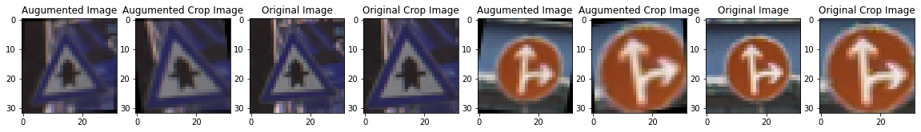
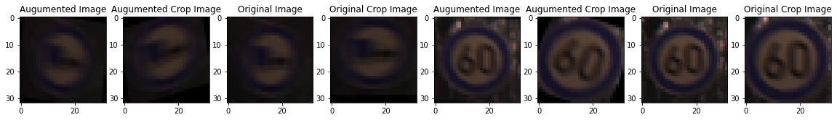
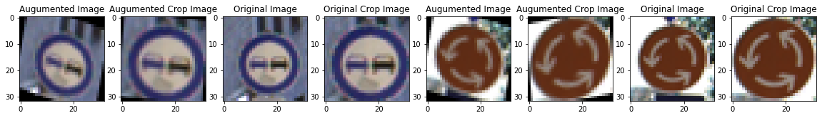
Image Augmentation

Slide 8
Training
I build three model using CNN and Transfer Learning
First model was build using Transfer Learning with ResNet50V2 Model
Second model was built using CNNs
Third model was build using Transfer Learning with VGG19 Model
Accuracy was used as metric in all three models
ADAM optimizer was used in all three models

Slide 9
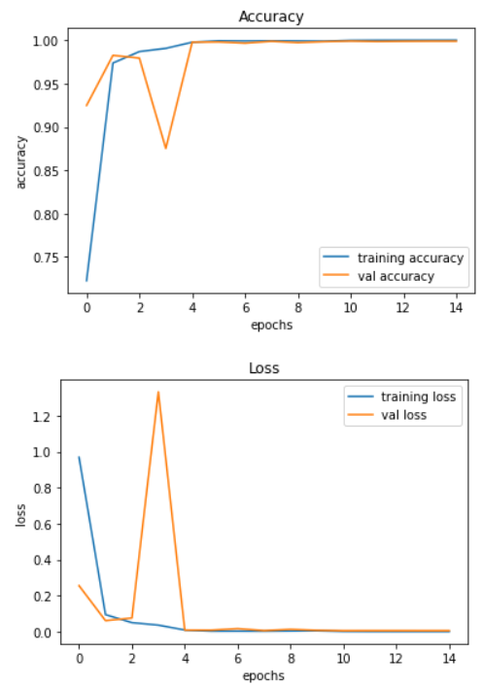
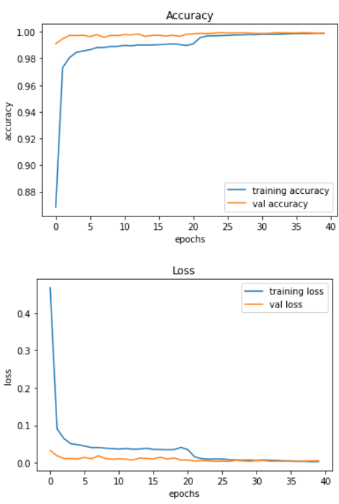
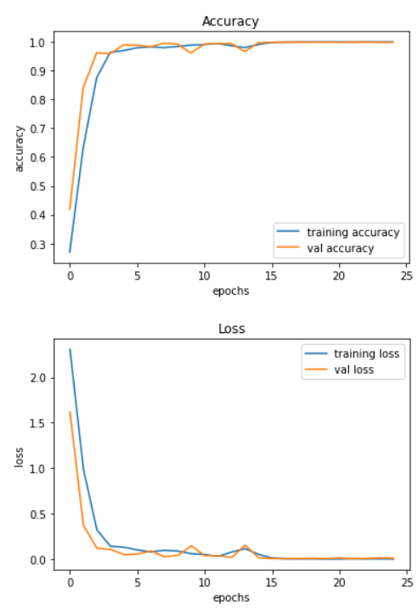
Model Performances / Histories

Slide 10
Model Testing
Model accuracies for the models were as follows
Model Name | Accuracy
CNN Model | 98.72%
ResNet50V2 Model | 96.61%
VGG19 Model | 98.33%
CNN model performed the best.

Slide 11
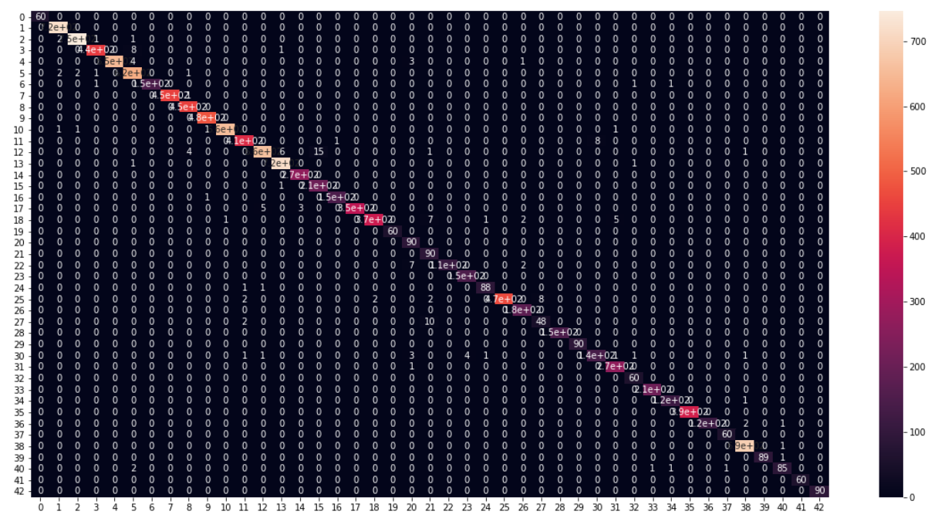
Confusion Matrix Heatmap for CNN model

Slide 12
Ensemble of the Models
Ensembling of the models had shown the significant improvement in accuracy
Ensemble model performance were as follows –
Type of Ensemble | Accuracy
Mean Ensemble (Soft Voting) | 99.07 %
Weighted Ensemble | 99.10 %
Mode Ensemble (Hard Voting) | 98.72 %
Weighted Ensemble had shown highest accuracy.

Slide 13
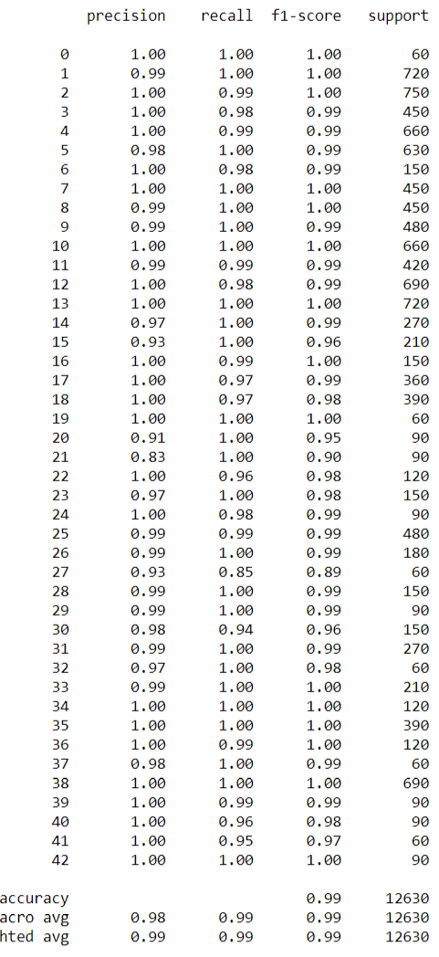
Classification Report of Weighted Ensemble

Slide 14
Future Improvements
More Image augmentation
Class balancing through Image augmentation
Increase the input image dimension
Use More Image generators for better ram management
Make the models reproducible.

